Slide 1
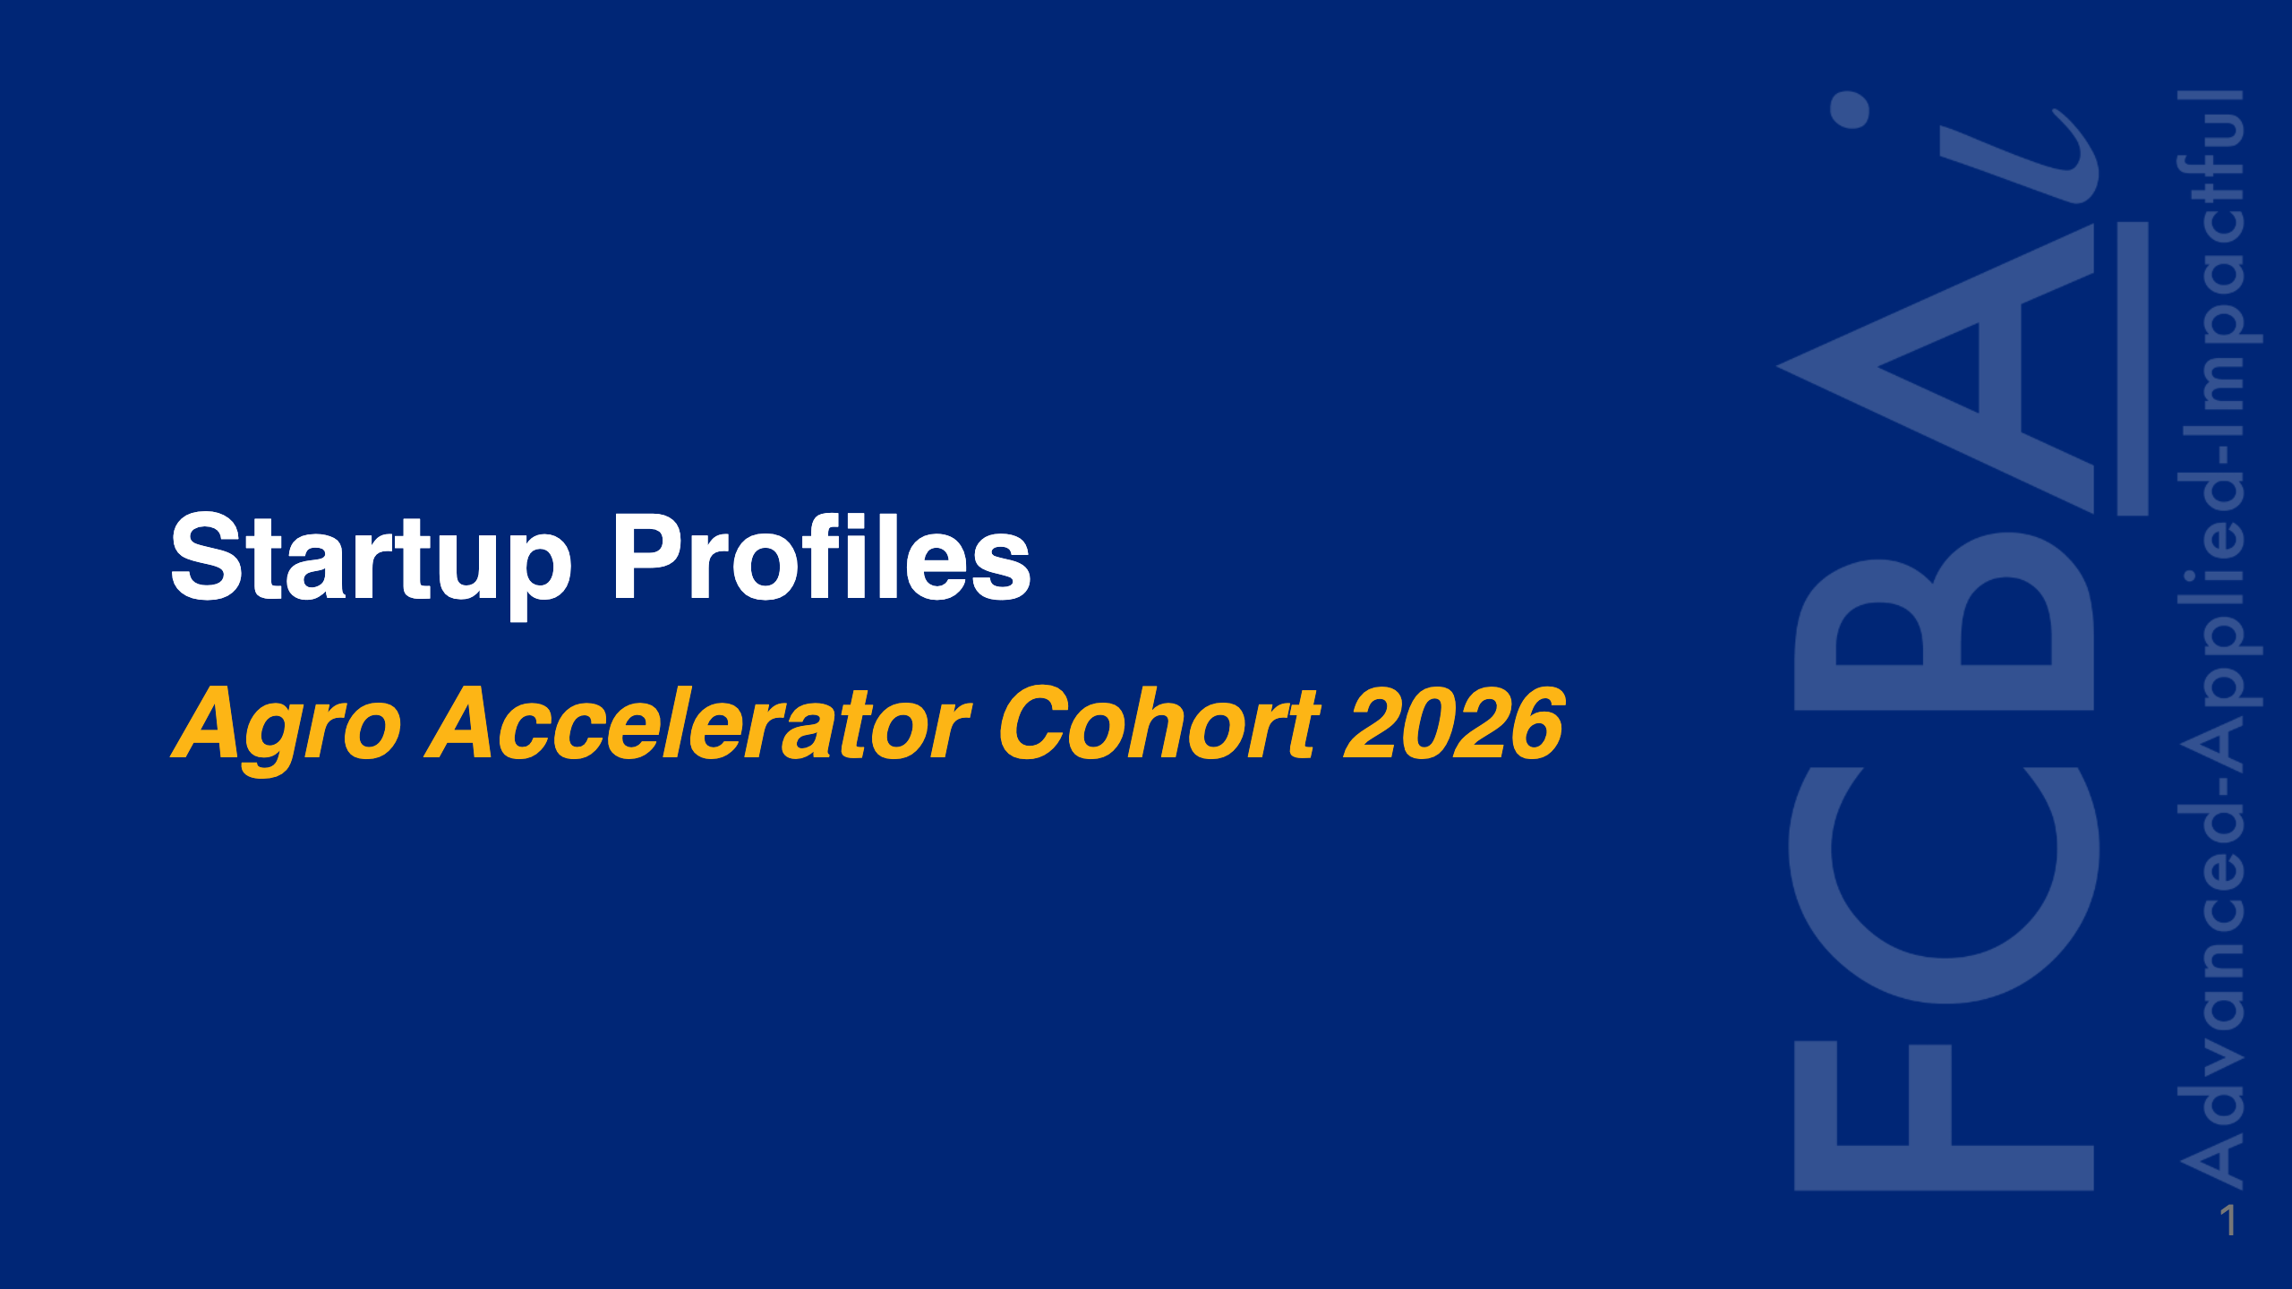

Slide 2
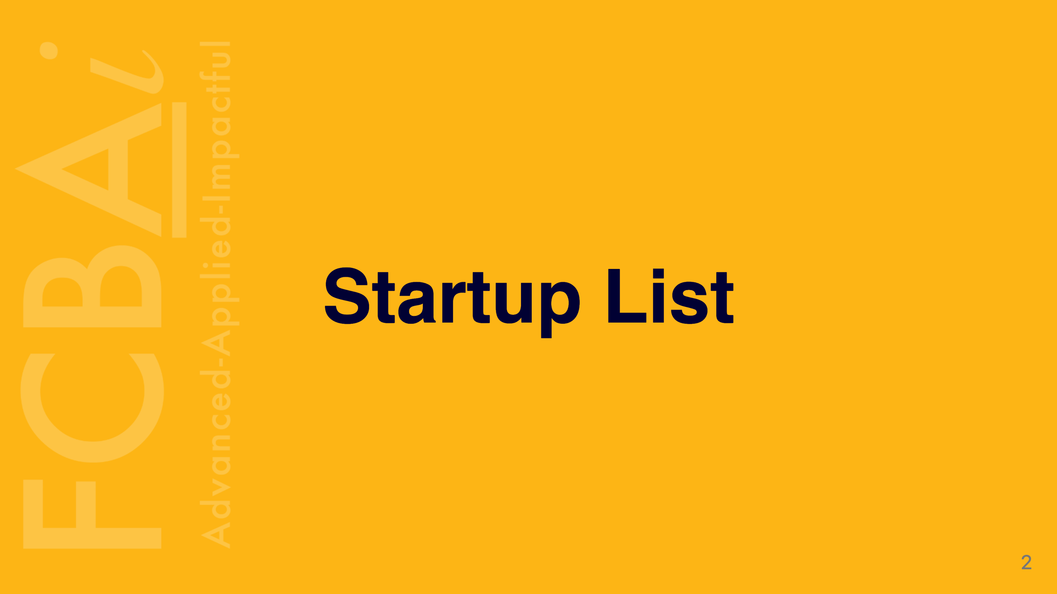

Slide 3
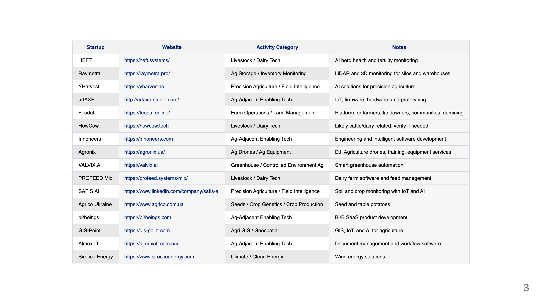

Slide 4


Slide 5
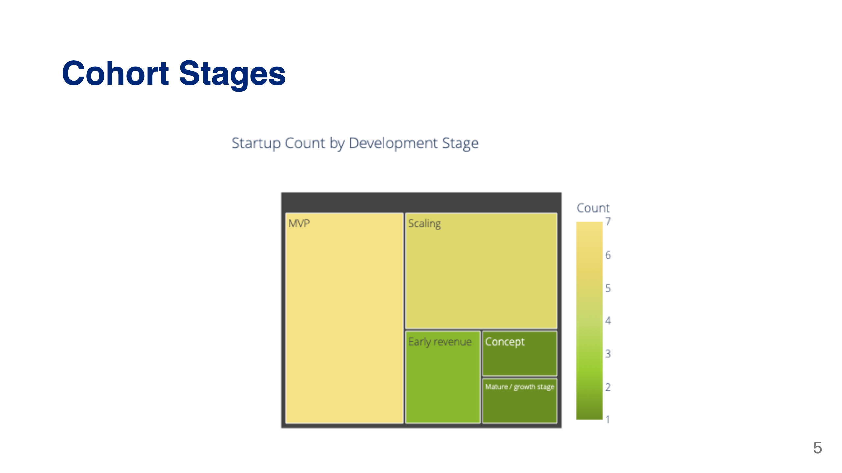

Slide 6
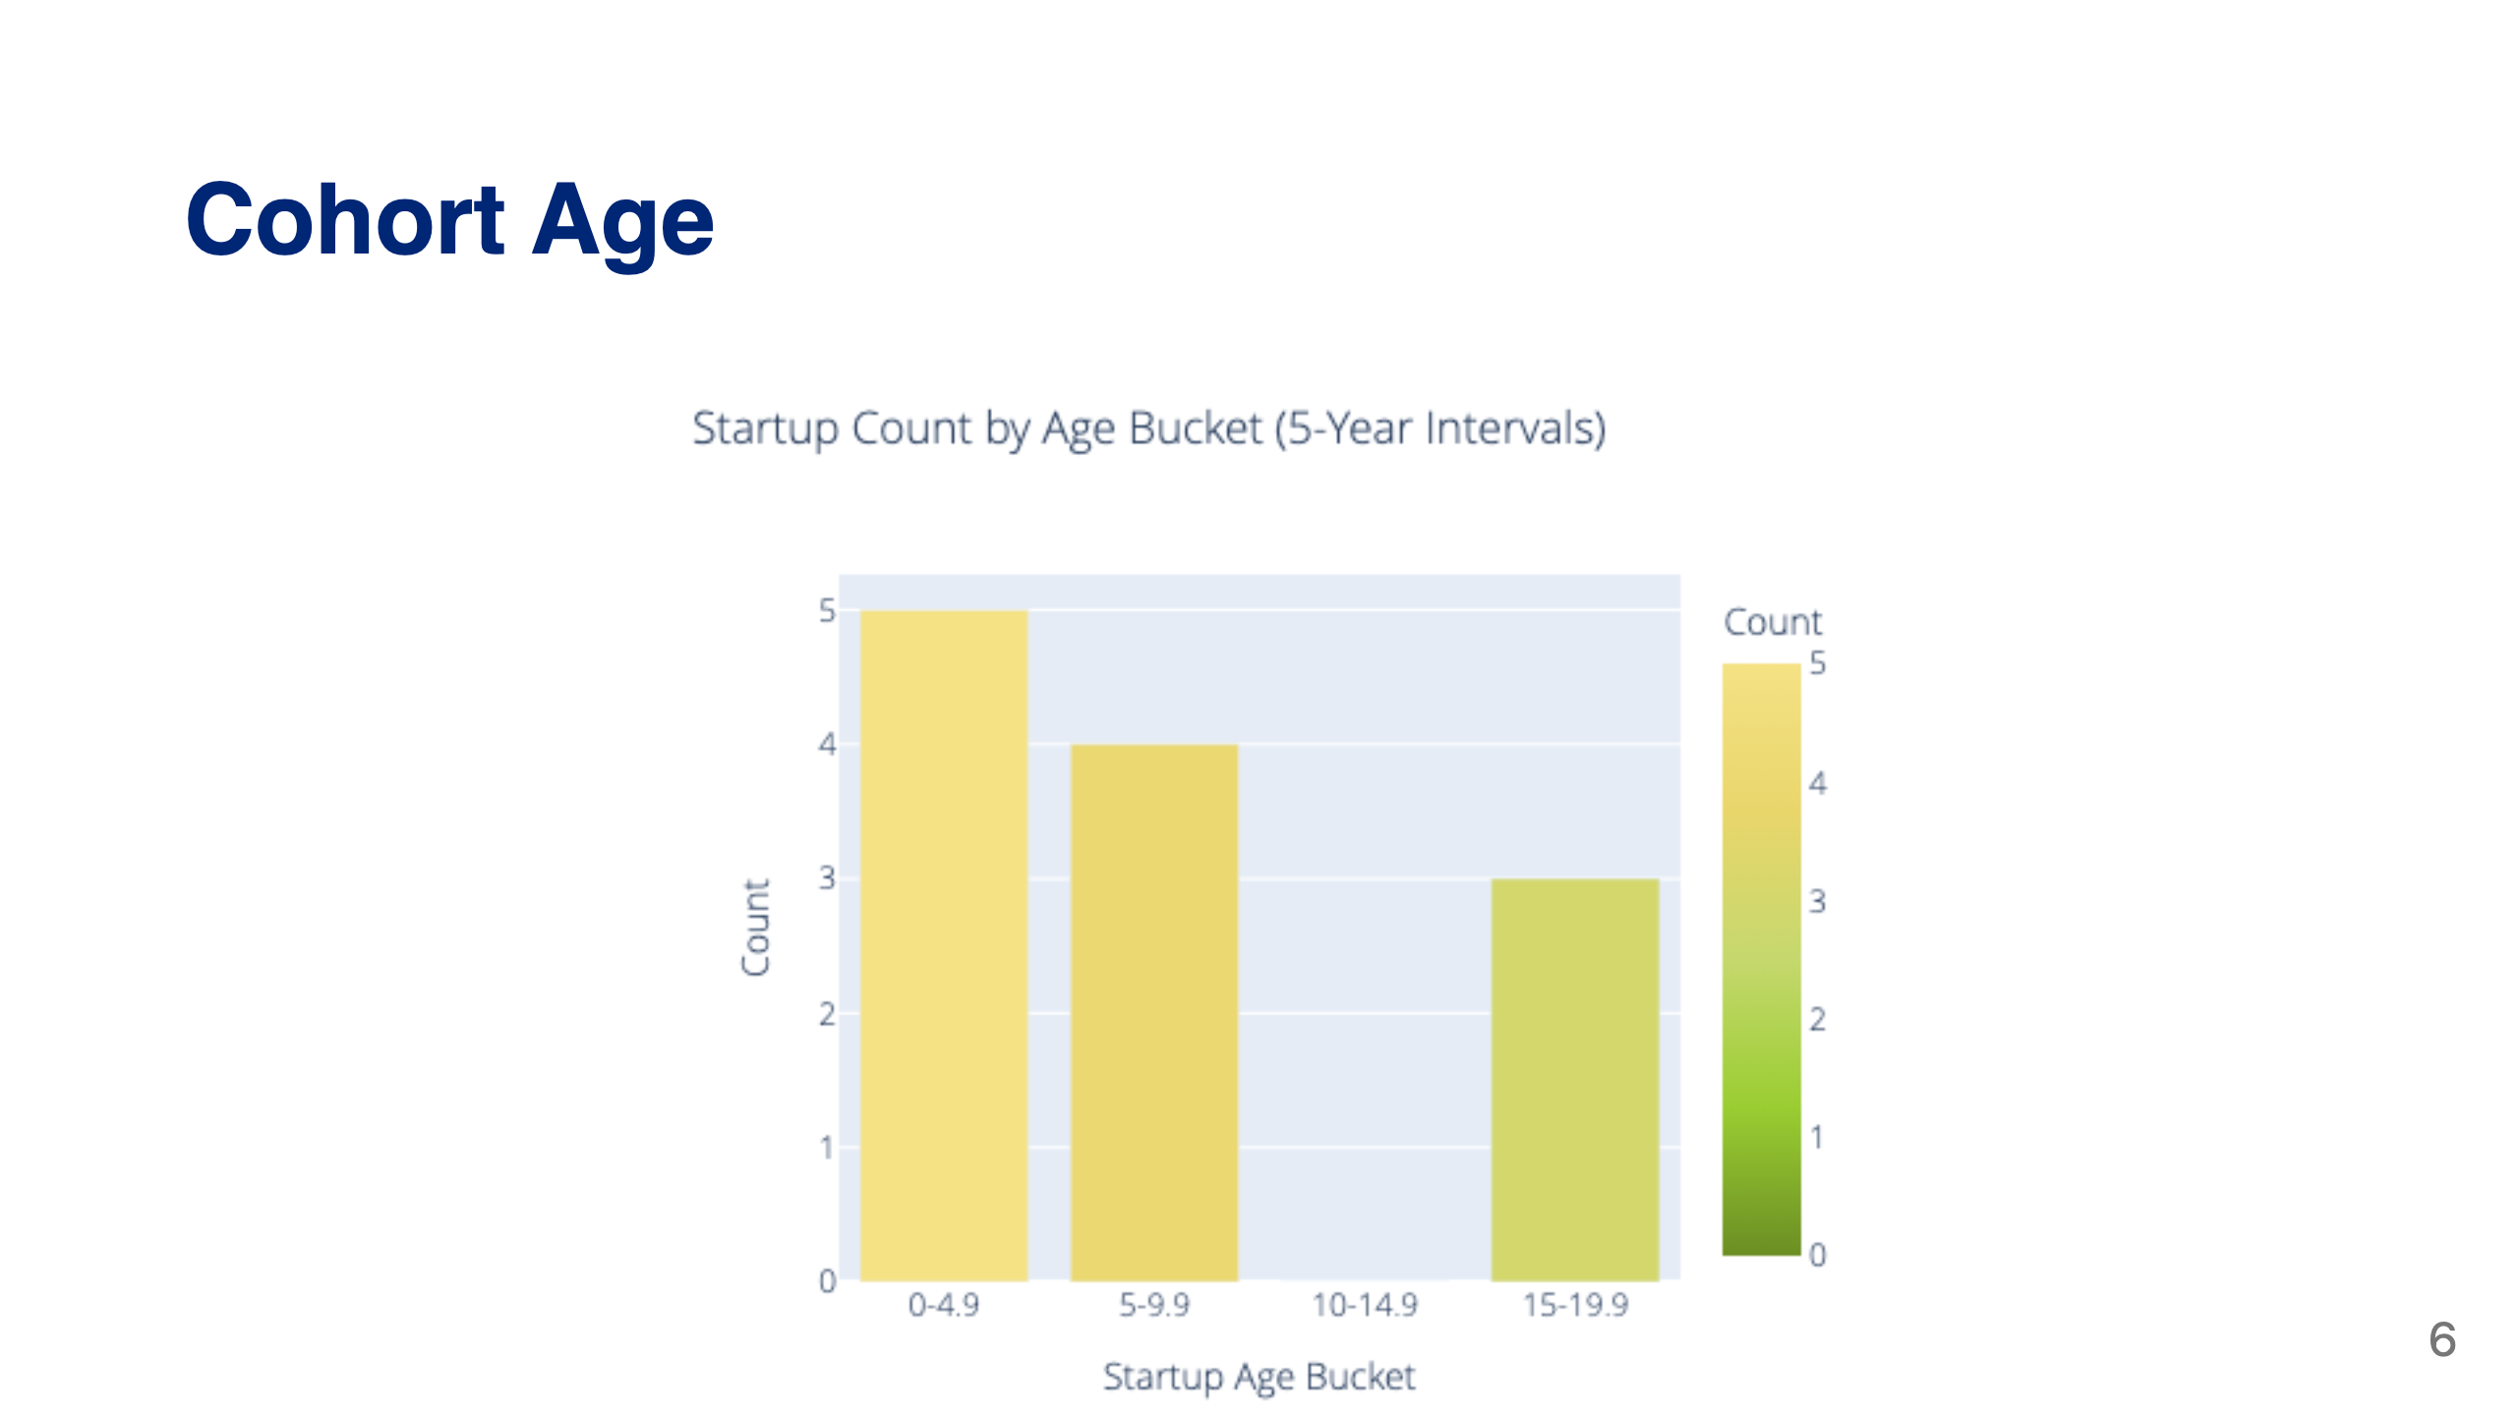

Slide 7
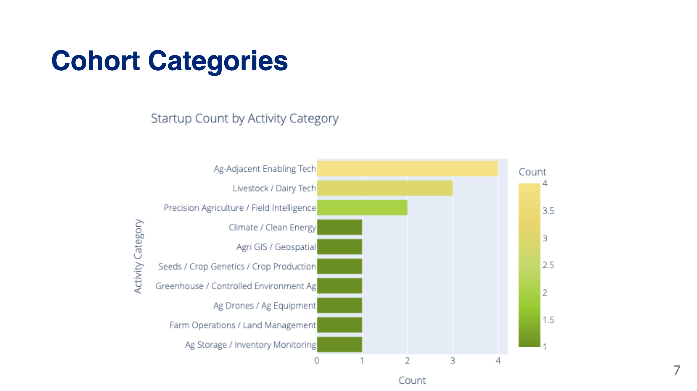

Slide 8
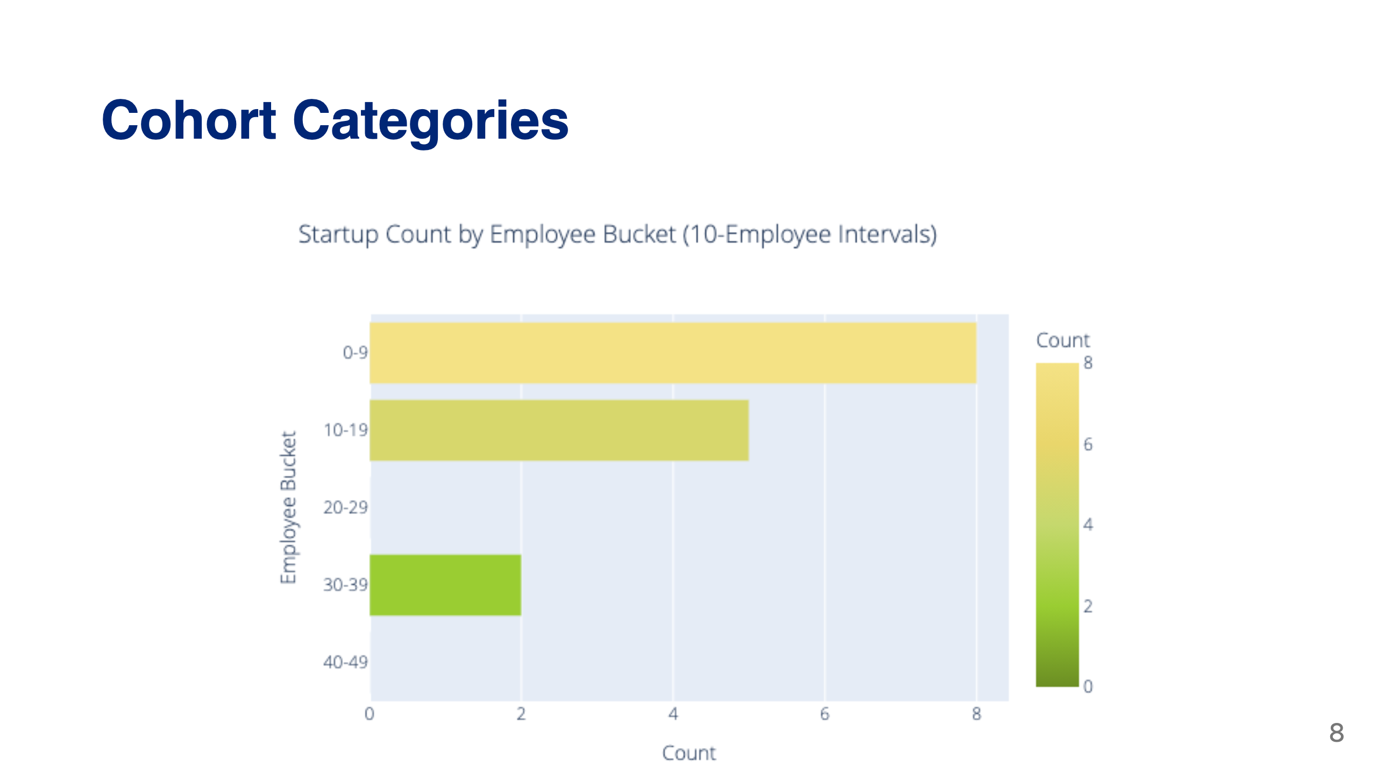

Slide 9
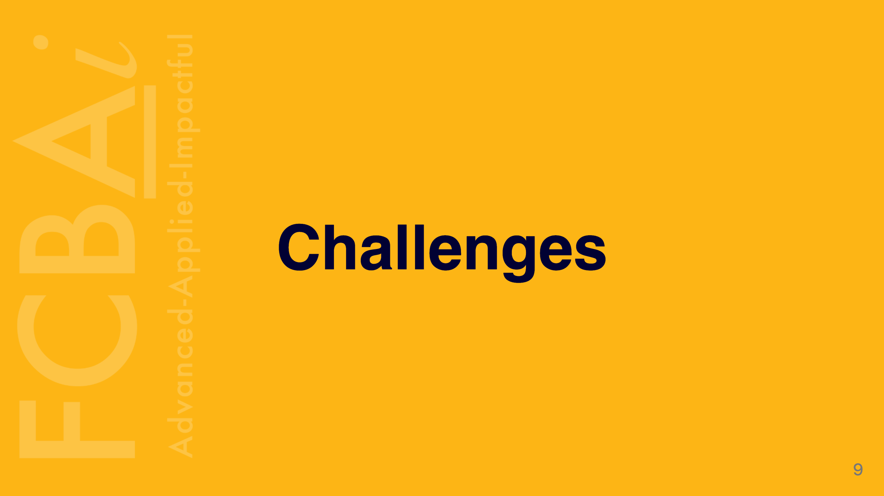

Slide 10
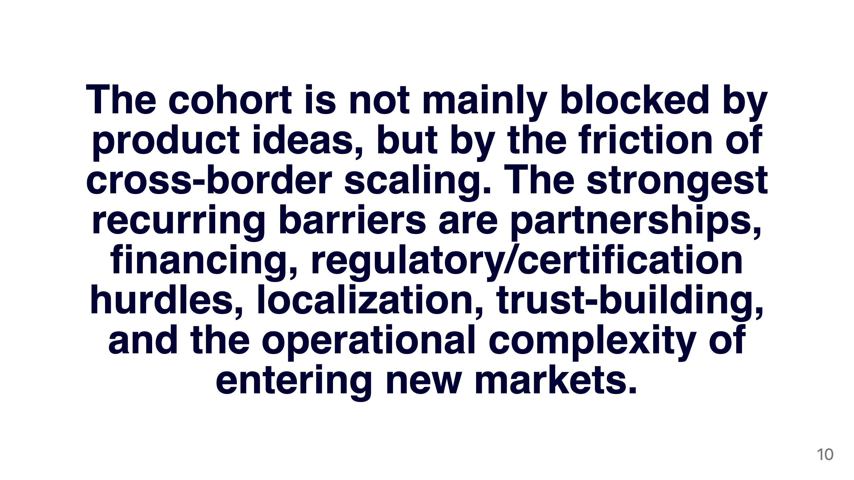

Slide 11
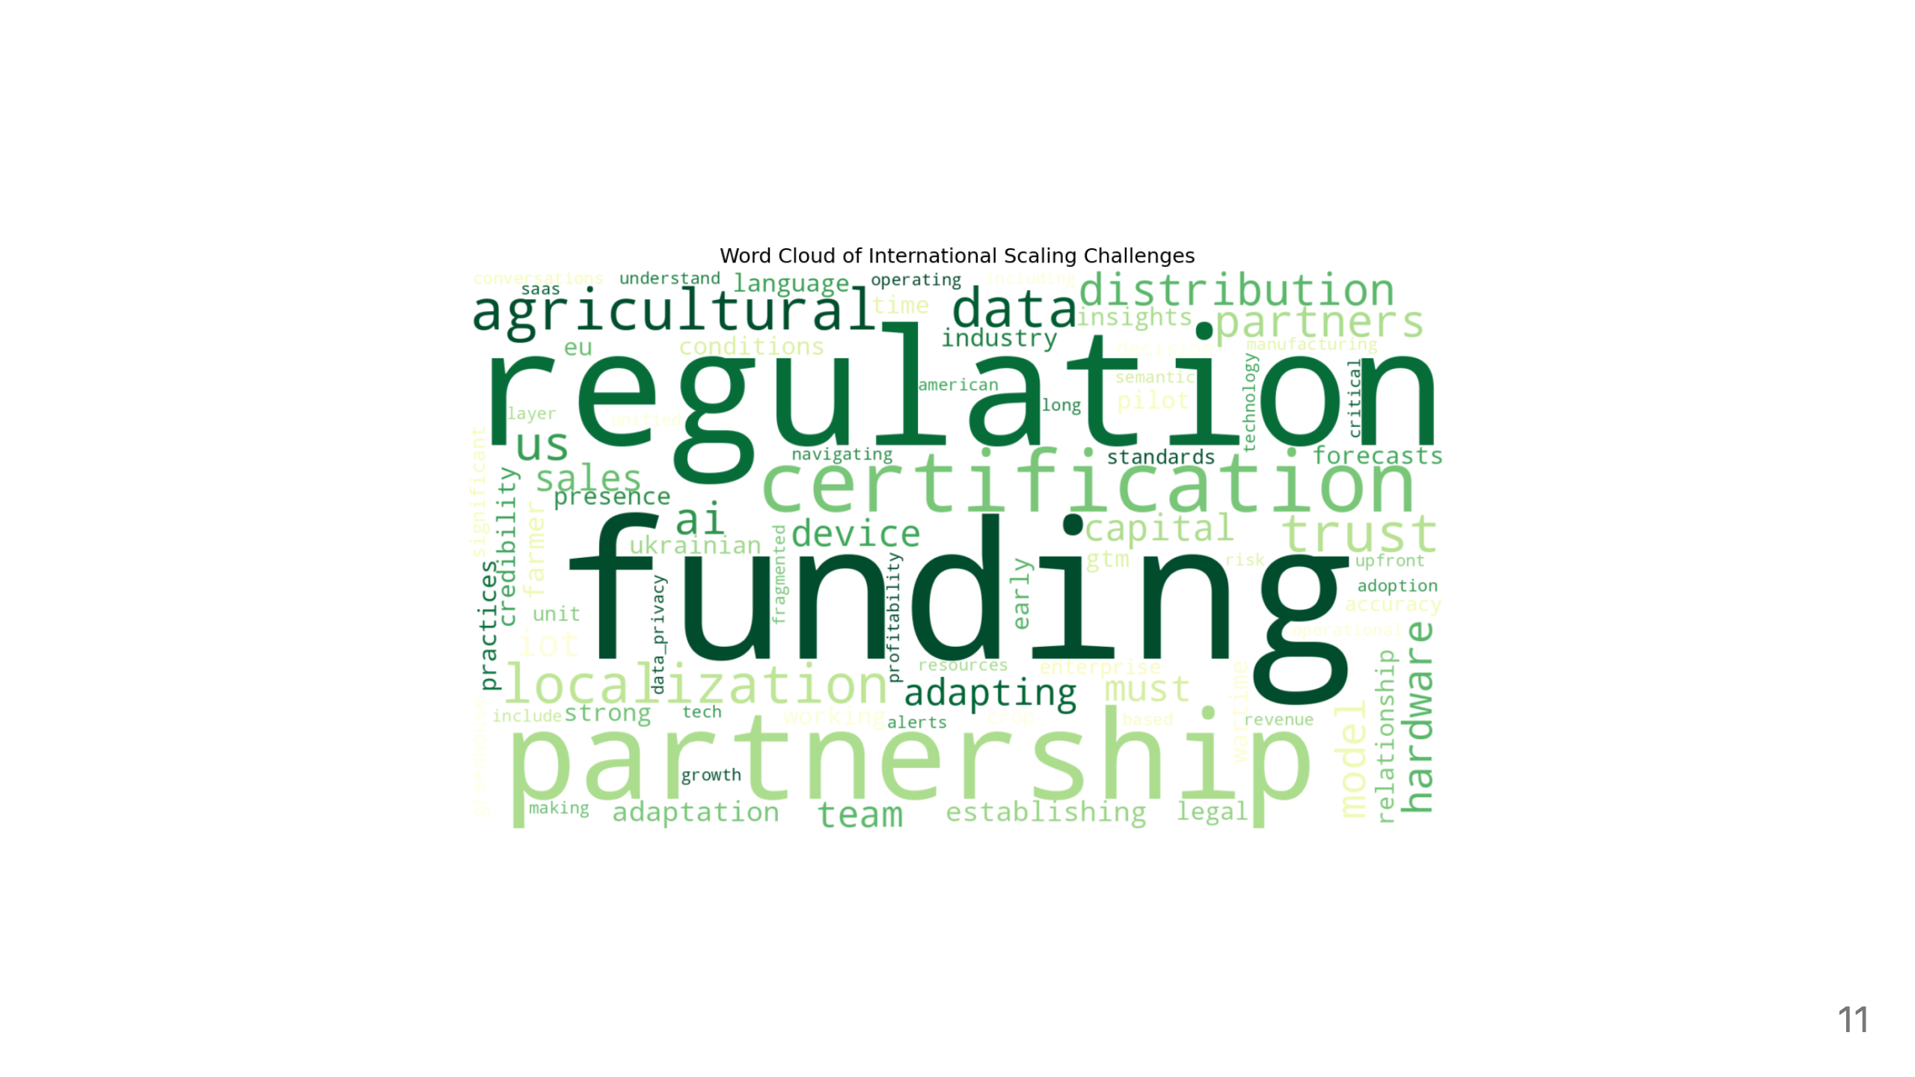

Slide 12


Slide 13
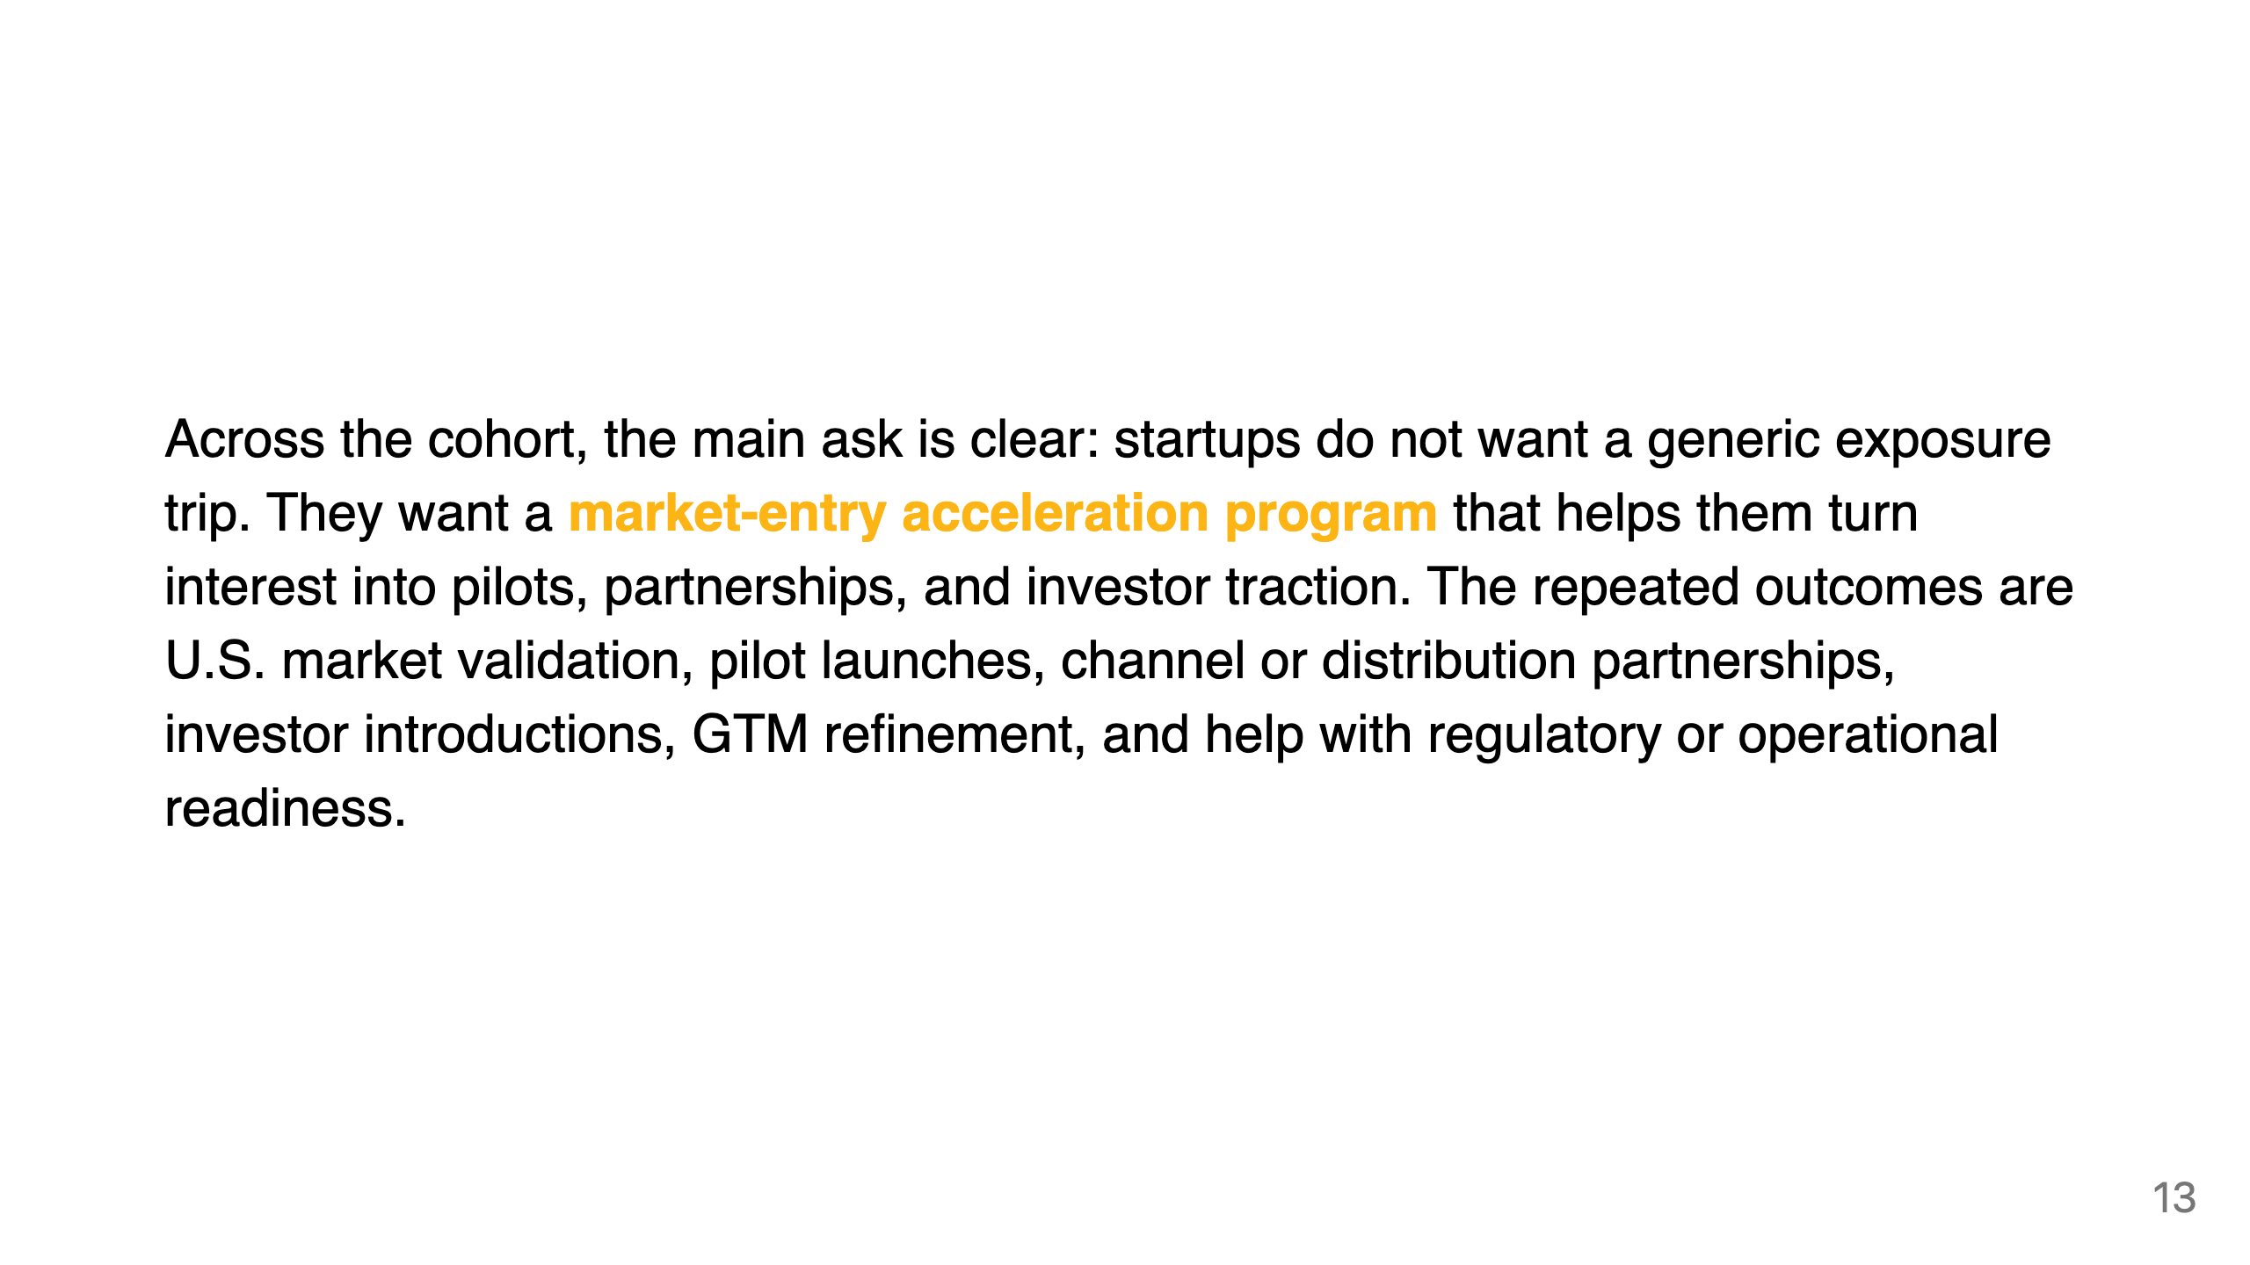

Slide 14
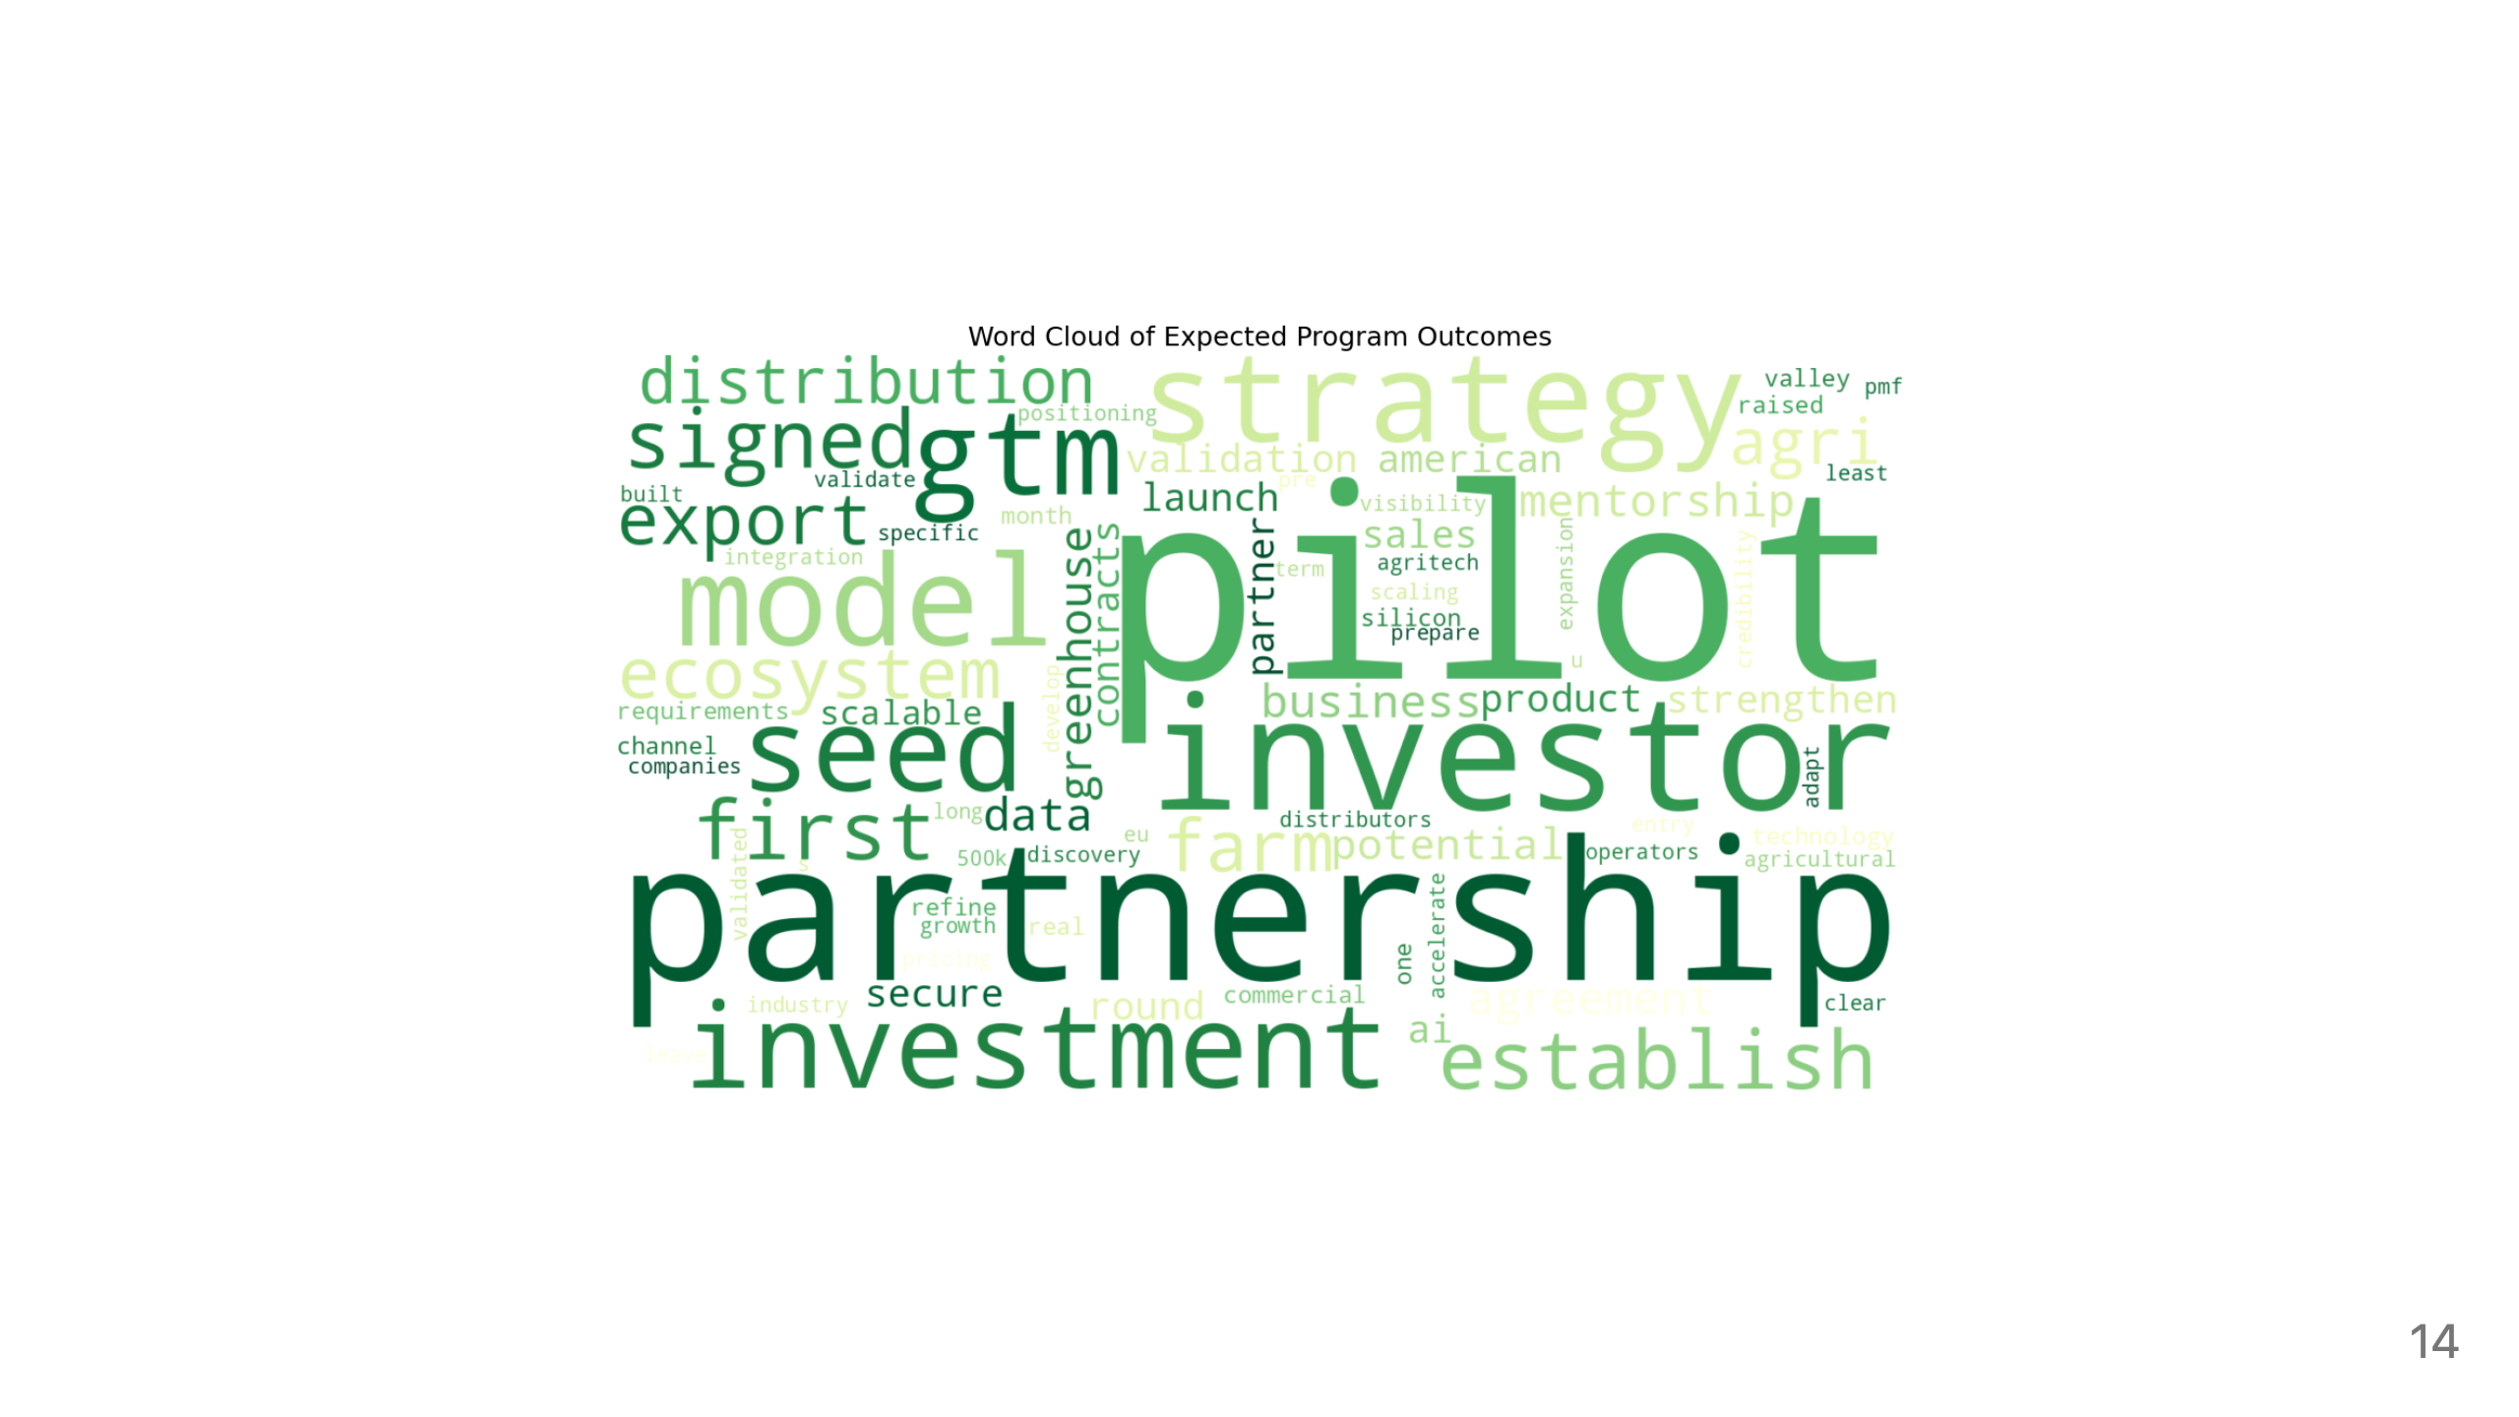

Slide 15
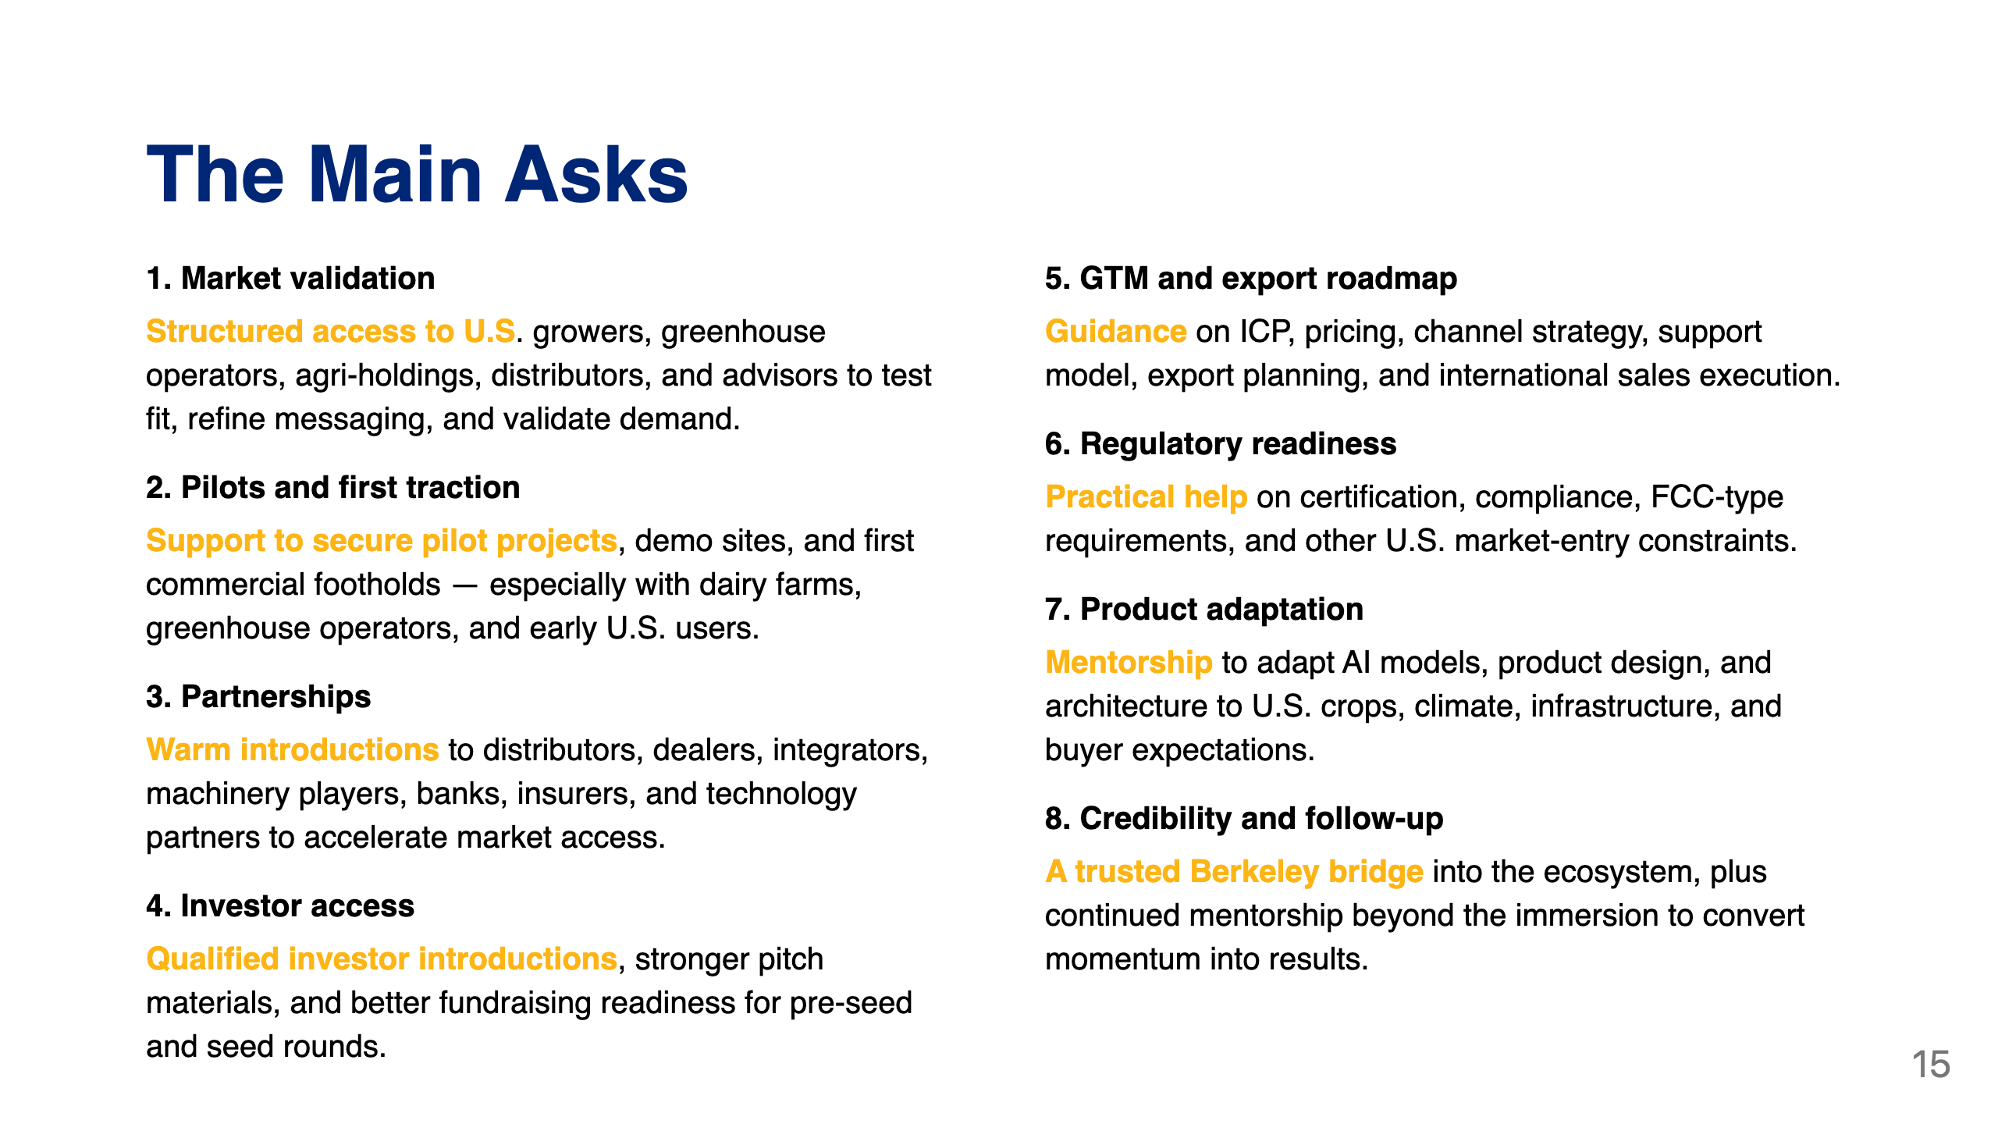

Slide 16

Notes:
1. **U.S. Ag market intelligence and customer discovery** 2. **Pilot design and pilot negotiation support** 3. **Partner matching: distributors, integrators, growers, ecosystem players** 4. **Investor readiness, storytelling, and curated investor meetings** 5. **GTM, pricing, and export roadmap workshops** 6. **Regulatory/compliance office hours** 7. **Technical adaptation and product feedback sessions** 8. **Post-program mentorship with milestone tracking**

